Slide 1
GDipSA 48 - Team 8
Java Continuous Assessment Slides

Slide 2
Our Team’s Assumptions
Manager can approve his own leave.
Admin cannot apply for leave.
There is no half-day leave.
Input dates are required when applying for leave. (Leave Start Date and Leave End Date must be entered)
Medical leaves include weekends and public holidays.

Slide 3
How the team carried work distribution :
Workload | Member In Charge
Administration (Employee CRUD, Leave type CRUD, Public Holiday CRUD) | Antonio and Hui Ching
Leave Application (Applying for leave after employee login, setting date limitations, validation logic etc) | Uday
Basic integration between admin and leave application and making holidays as an exception | Hui Ching
Leave Application (View/edit/cancel leave, other constraints on leave, integrate with apply leave) | Zack
Manager Approval/Rejection (Approval of leave depending on which employee reporting to which manager, pagination, search and view leave history) | Kyaw, Wei Sheng and ZhongBo
Integration between Admin, Leave Application and Manager Approval | Kyaw
Reporting and Email interaction | Kyaw

Slide 4
Architecture/Layer Description
Controller
Employee Controller
Leave Controller
Manager Controller
Public Holiday Controller
Common Controller
Incoming Request
Front Controller
Response
model
Receive
Invoke
Application Server
model
Business Processing
Renders Response
JPA
Login
Leave Submission
Leave Record
Application History
Logout
Service
Get data
Receive Data
mySQL
View
Database

Slide 5
Architecture/Layer Description
Incoming Request
Front Controller
Controller
Model
Return Response
Invokes
Returns control
Receive
data
Model
Renders
response
Business
Processing
View
Templates
Service
JPA
Get data
Receive
data
Data
Base

Slide 6
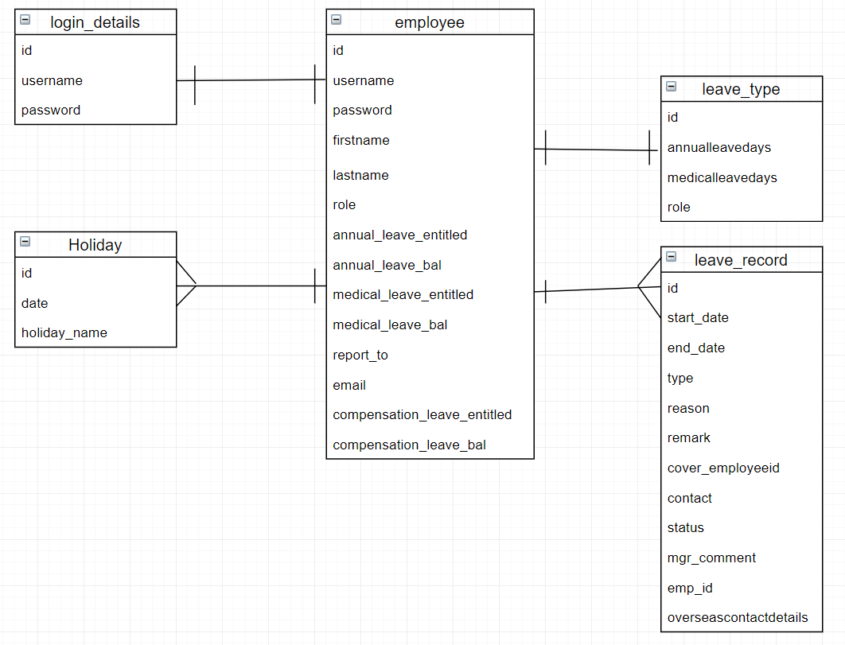
Entity-Relationship Diagram (Model)

Slide 7
Technologies Used :
Webpage / Client-Side
Thymeleaf
HTML
CSS
jQuery
2. Web Framework
Maven
Spring Boot (Spring Framework)
JpaRepository
Annotations-based Mapping
3. Database Connection
MySQL
Hibernate
JPA (Java Persistence API)

Slide 8
Lessons learnt during the project:
Increase coding proficiency by using Java and creating a web application using Java with Spring Framework
Persist data into Database (MySQL Workbench) using JPA and Hibernate.
Creating an HTML webpage using ThymeLeaf.
Understanding the architecture of Spring Framework.
The importance of communication between team members.
Integrating codes between several team members (for example different naming convention, different database schema, various service classes.)
Project Collaboration using Github, tracking code changes during the development phase.
Debugging for any critical errors while testing the project.

